Slide 1
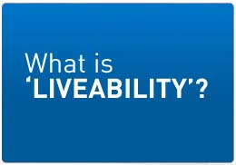
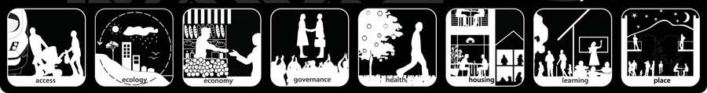
Lesson 3 & 4

Slide 2

'Liveability' - the qualities of a place (city, town, suburb, neighbourhood) that contribute to the quality of life experienced by residents and others.

Slide 3

‘Liveability’ – Cities
Environmental
Infrastructure
Cleanliness, dust, pollution, noise, air and water quality,
personal security, traffic safety, community identity and pride,
historic structures, architectural styles, streetscapes
streets, public transport, health, shopping centres, etc
Economic
Value of property
Social
Cultural
Small cows eat every icecream

Slide 4




Most & Least ‘Liveable’ Cities
http://www.telegraph.co.uk/travel/10270269/The-worlds-most-liveable-cities-2013.html?frame=2654758
http://www.telegraph.co.uk/travel/travelnews/10270633/The-worlds-least-liveable-cities-2013.html
IMAGES

Slide 5

Create a iMovie Trailer of the 10 most and 10 least ‘liveable’ cities in the world
Use the expedition template
= 20 images and 8 written
Slides (keynote)
Don’t forget to save large images
to use

Slide 6


Work on the cover of your
magazine

Slide 7

Most & Least ‘Liveable’ Cities
https://www.youtube.com/watch?v=s7JkpEHau3o

Slide 8
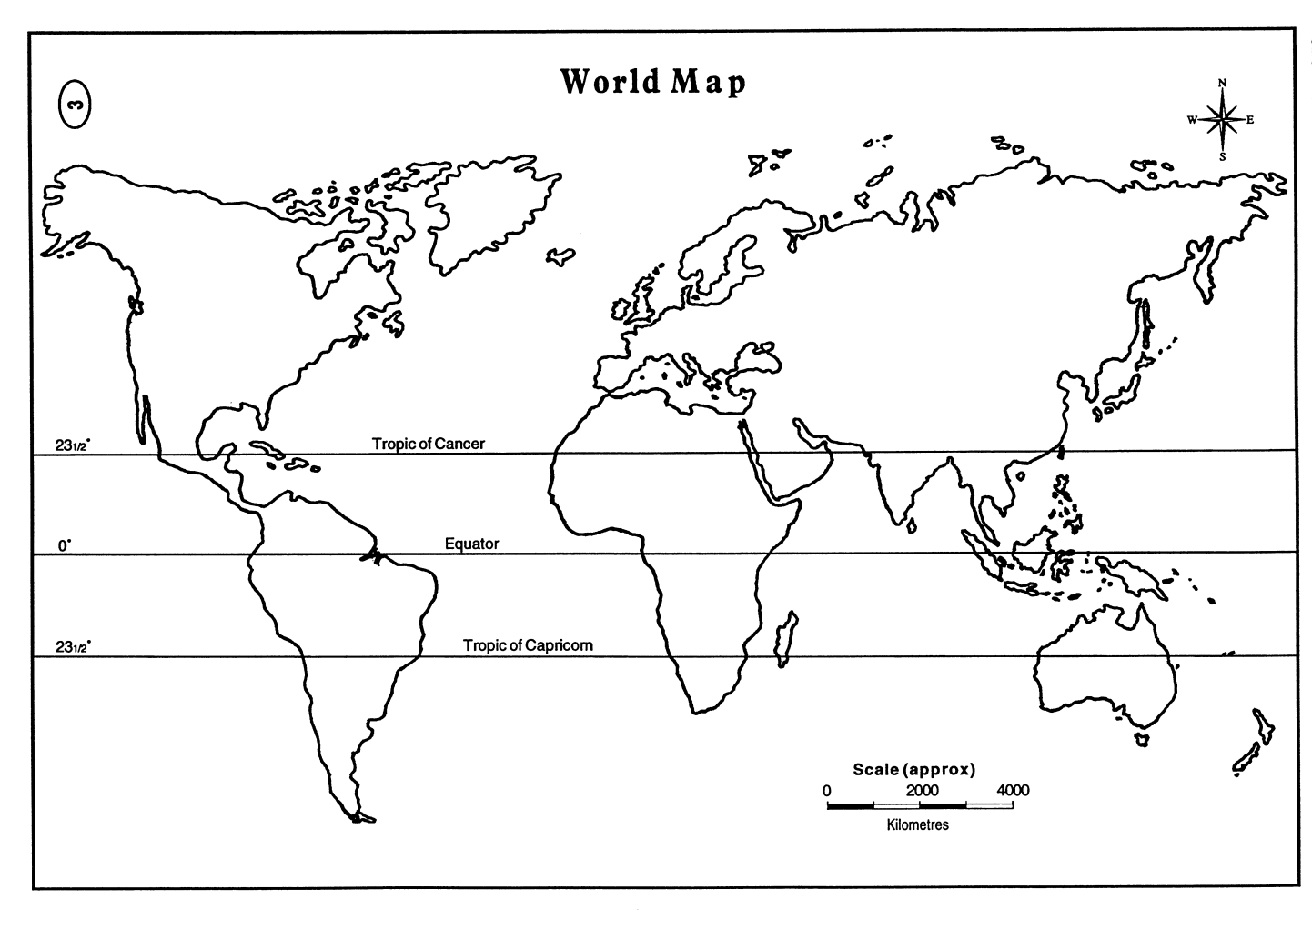

Mapping the
Most & Least ‘Liveable’ Cities

Slide 9

Bangladesh
Legend
Melbourne
Liveable
Unliveable
‘Liveability’

